Slide 1

Final Assignment Presentation
By: Seyed Ali Firooz Abadi

Slide 2
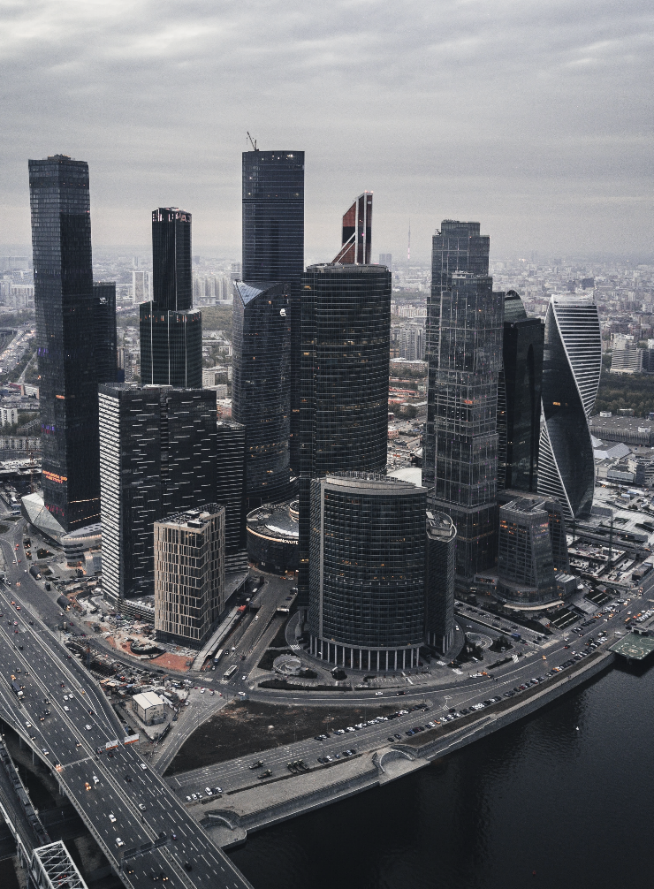
1
Prog 01 : Extractor

Slide 3
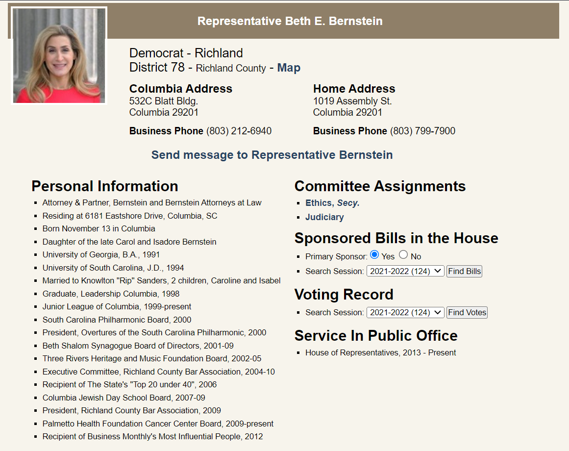
Prog 01
OVERVIEW
District 78
Python 3

Slide 4
Prog 01
EXTRACTED DATA
Full Name:
Beth E. Bernstein
--------------------------------------
County:
Richland County
--------------------------------------
Political Party:
Democrat
--------------------------------------
District:
78
--------------------------------------
Columbia Address:
532C Blatt Bldg.
Columbia 29201
--------------------------------------
Home Address:
1019 Assembly St.
Columbia 29201
Phone Number:
(803)212-6940
(803)799-7900
--------------------------------------
Personal Information:
1- Attorney & Partner, Bernstein and Bernstein Attorneys at Law
2- Residing at 6181 Eastshore Drive, Columbia, SC
3- Born November 13 in Columbia
4- Daughter of the late Carol and Isadore Bernstein
...
--------------------------------------
Committee Assignments:
1- Ethics, Secy.
2- Judiciary
--------------------------------------
Service In Public Office:
House of Representatives, 2013 - Present

Slide 5


Prog 01
HIGHLIGHTS
Parsing Techniques
Online and Offline
Using 2 parsing methods, “lxml” to handle bad files and “html5lib” to better organize the HTML
The program will try to access the website in real time, but if it fails, it will use an offline version.

Slide 6

2
Prog 02 : Processor

Slide 7


Prog 02
CODE ORGANIZATION
CLASS Person
CLASS ToString
This holds the representor information
De-pickling
@Property
Return a string from list based on a separator (custom or default)
Check input to exit

Slide 8
Prog 02
HIGHLIGHTS
Method overloading
Using *args as a parameter to pass to method.
Reusability
Dictionary (
Full_Name = [firstName, middleName, lastName],
Home_Address = home_address,
Columbia_Address = columbia_address,
Phone_Number = phoneNum_list,
Party = party,
County = county,
District = district,
Personal_Info = personal_info_list,
Committee_Assignments = committee_assignments_list,
Service_Time = service_time )

Slide 9

3
Prog 03 : UI

Slide 10
Prog 03
CODE ORGANIZATION
Abstract_Chat_Class
basicCheck (question, Object person)
advancedCheck (question, Object person)
trainingList
strTrainingList
ChatManager
ImportPerson (districtNumber)
answerQuestions(question)
Basic_Info
Other_Info
Personal_Info
Bot_Info

Slide 11
Prog 03
HIGHLIGHTS
Regular Expression

Slide 12

4
Prog 04 : QueryMapper

Slide 13
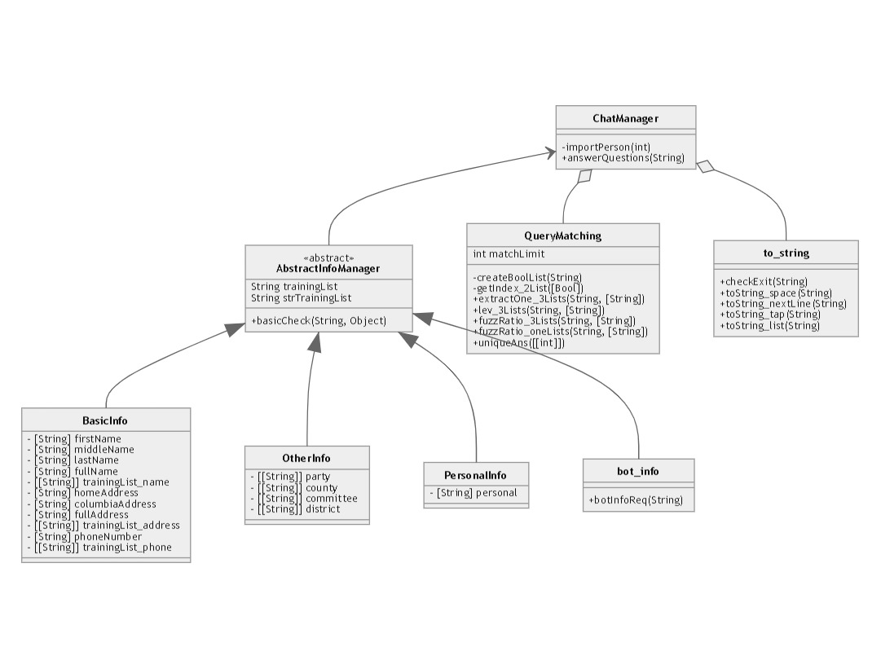
Prog 04
CODE ORGANIZATION

Slide 14
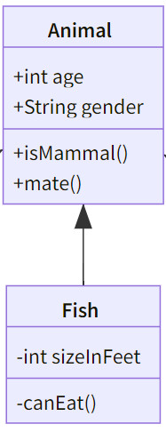
Prog 03
HIGHLIGHTS
Fuzzywuzzy & Levenshtein
Mermaid UML
Animal <|-- Fish
Animal : +int age
Animal : +String gender
Animal : +isMammal()
Animal : +mate()
class Fish {
-int sizeInFeet
-canEat()
}

Slide 15
5
Prog 05 :

Slide 16
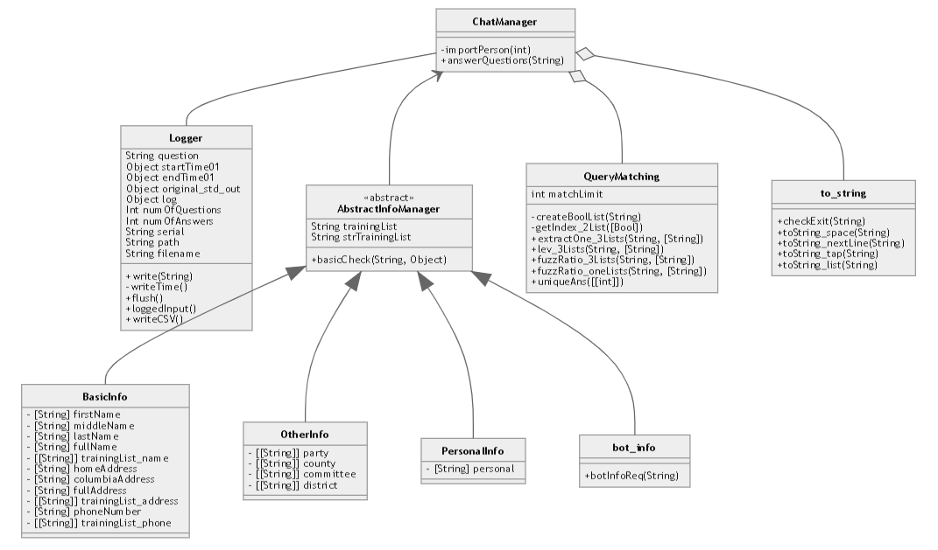
Prog 05
CODE ORGANIZATION

Slide 17
Prog 05
HIGHLIGHTS
Creating folders / files
Try: Read / access the file / folder
Except: Create the file / folder
Then: Append information to file
Manipulated print()
Originally
print() ==> write() ==> sys.stdout
Manipulated:
print() ==> LoggerClass ==> write() ==> append to file + sys.stdout
Manipulated input()
myMethod() ==> input() ==> append to file ==> return input str

Slide 18
Overview
HIGHLIGHTS
Snapshot
Test Video
please enter the district number you are interested in:
>>> 78
Welcome
Now let's play a game
Remember that you can just type quit or exit anytime to exit the program
Have fun
What do you want to know?
>>> what's the name of my repo
You requested information regarding the name of your representative:
Beth E. Bernstein
What do you want to know?
>>> does she swims a lot?
Sorry I couldn't understand you, please rephrase your question.
What do you want to know?
>>> q
Have a good day, bye
Process finished with exit code 0
https://youtu.be/VFGppk7KbUY
Testing
Developing
1. text to dict method
2. implement RE as a first step

Slide 19
Questions ?

Slide 20
THANK YOU

